Slide 1
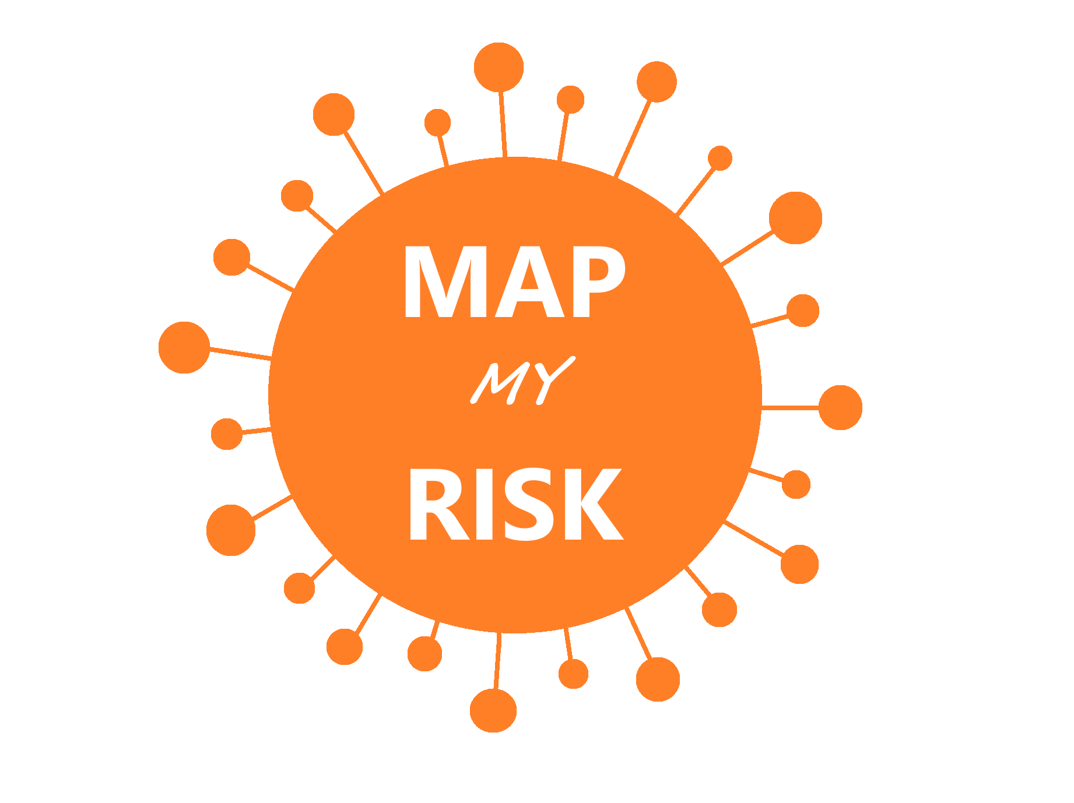
Battling the Disruption of Daily Lives
with a Smarter Solution
Team Ada Lovelace: Sofia Sikandar, Arias Hathaway, Hieu Dinh, Gabriela Trindade, Fiona Tan
GitHub Repository: https://github.com/sofiasikandar1/teamlovelace
Main Jupyter Script: https://github.com/sofiasikandar1/teamlovelace/blob/master/map_my_risk_codes.ipynb

Slide 2
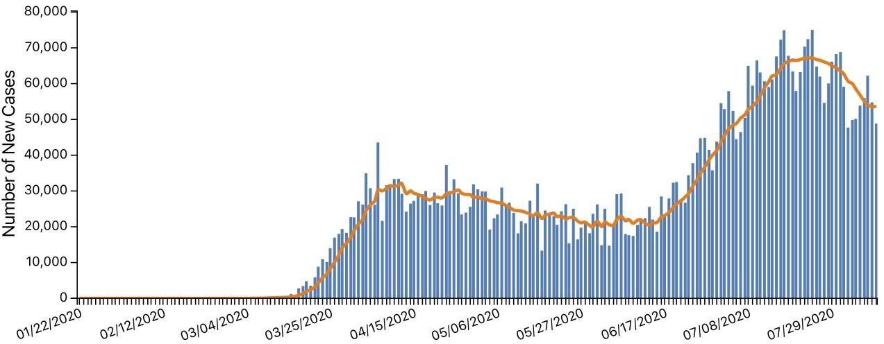
With the growth of COVID-19 cases in the U.S.,
people are wondering...
New Cases in the United States
Source: https://www.cdc.gov/coronavirus/2019-ncov/cases-updates/cases-in-us.html

Slide 3


Is it too risky to go there?
Retail Store
Grocery Store
Park
Transit Station
Notes:
https://snipstock.com/image/png-images-pngs-thinking-thinking-woman-2-png-70759

Slide 4

Team Ada Lovelace has crafted a machine learning solution with a Mock Up for an Application called Map My Risk. Map My Risk instills predictability to battle the uncertainty COVID-19 has brought to the daily lives of residents in the United States.

Slide 5

Map My Risk on the Frontend

Slide 6
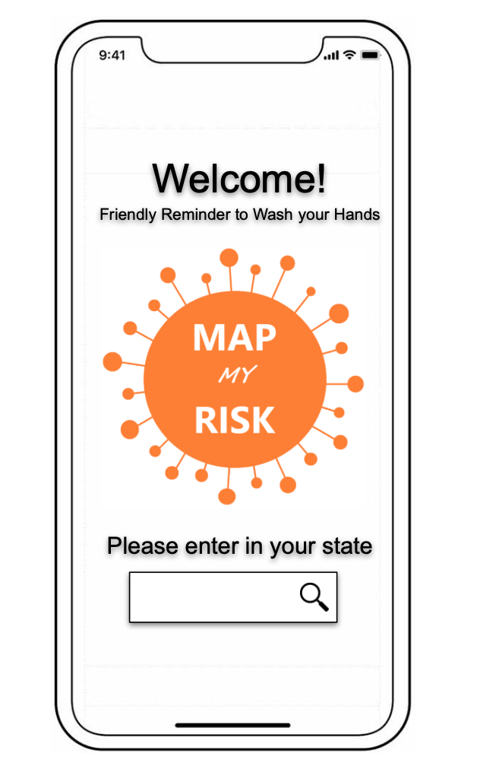
Upon launching, Map My Risk greets and prompts you to enter in your state. The Application is best used before leaving your home. United States residents can be informed of the risk of infection in their state.

Slide 7
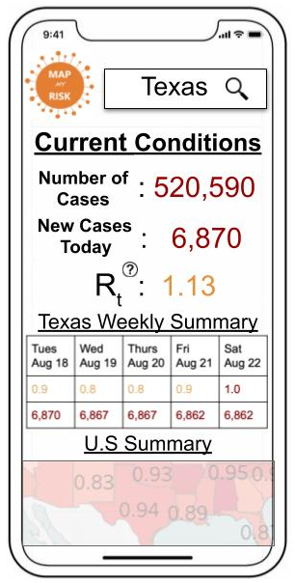
When a user enters in their state, Map My Risk provides the current total cases, new cases and R_{t} value (rate of transmission of the virus) in the specified state, the weekly forecast of transmission rates and new cases*, and the nationwide summary
*Only transmission rate is forecasted by our model. Forecasted new cases can be pulled from another existing model.

Slide 8
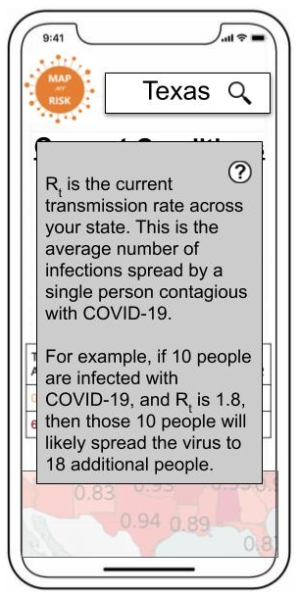
Upon clicking on the question-mark icon, Map My Risk gives users a baseline understanding of the rate of transmission (R_{t}). Additionally, the application informs users of its significance. Our machine learning model predicts the rate of transmission (R_{t}) within the inputted state at the time the user accesses the application.

Slide 9

Map My Risk on the Backend

Slide 10
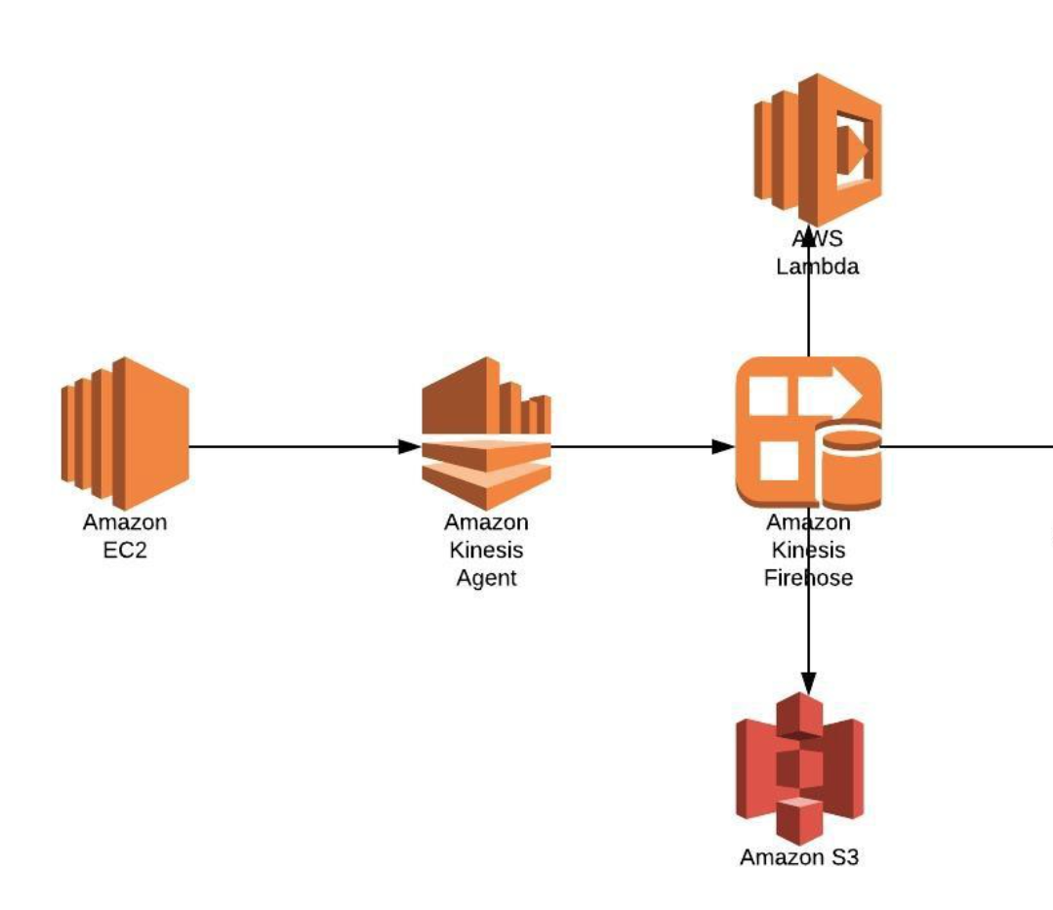

Application Pipeline
Amazon Sagemaker

Slide 11
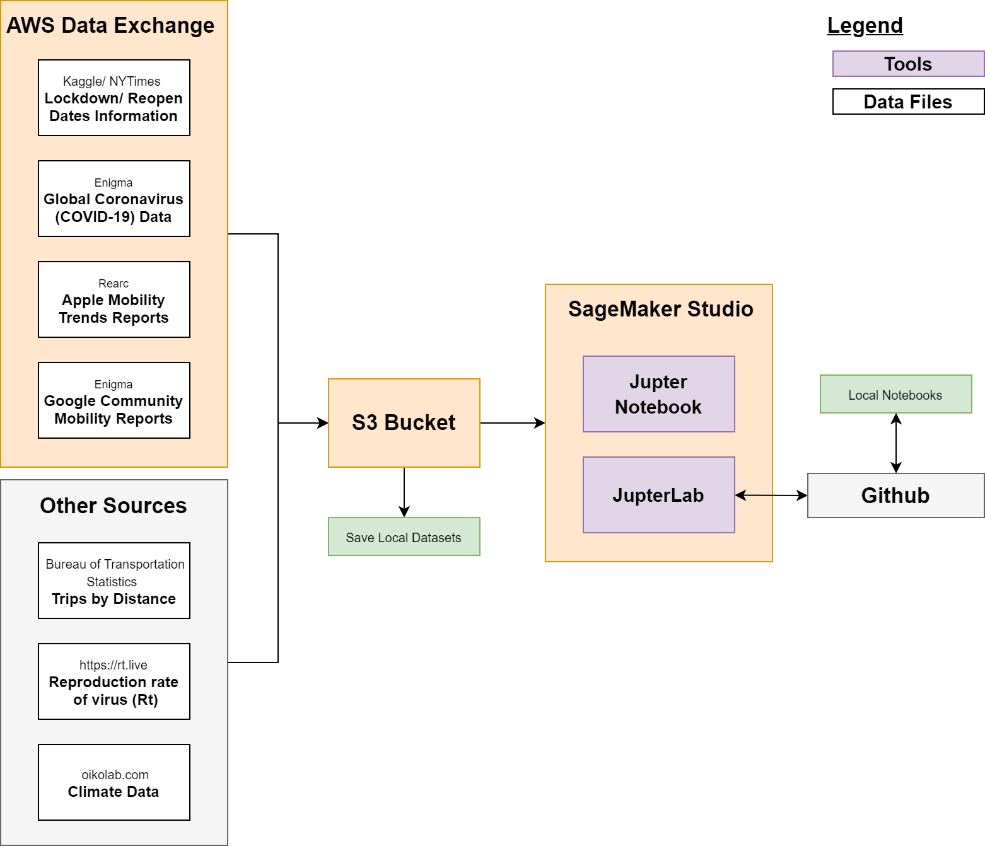
Data Sources

Slide 12
Data Sources
Data source | Features | Description
COVID-19 U.S. Reopen & Shut Down Status by State (NY Times & Kaggle) | Lockdown date Reopen Date | Lockdown and reopen dates per state
Global Coronavirus (COVID-19) Data | Population Cases Deaths Recovered | Daily number of cases, deaths, recovered, active, tested, hospitalized, discharged, ICU
COVID-19 Apple Mobility Trends Reports | Mobility city driving Mobility city transit Mobility city walking Mobility county driving | Daily relative volume of directions requests per country/region or city compared to a baseline volume on January 13th, 2020

Slide 13
Data Sources Continued
Data Source | Features | Description
Google COVID-19 Community Mobility Reports | Retail and recreation % change from baseline Grocery and pharmacy % change from baseline Parks % change from baseline Transit stations % change from baseline Workplaces % change from baseline Residential % change from baseline | Daily movement trends over time by geography, across different categories of places such as retail and recreation, groceries and pharmacies, parks, transit stations, workplaces, and residential compared to a baseline
Bureau of Transportation Statistics | Number of trips Population staying home Population not staying home | Estimated daily travel (# of trips) and number of people staying home and not staying home
Reproduction rate of virus | Transmission rate (R_{t}) New cases | Daily transmission rate (R_{t}) - estimate of how many secondary infections are likely to occur from a single infection in a specific location
Oikolab climate data | Temperature median Wind speed median | Daily weather data (temperature, wind, etc)

Slide 14
Assumptions, Challenges and Limitations
Chose state level data because lockdown/reopen dates were known at the state level
States’ lockdown/reopen statuses are obscured by the variety of policies across states including which sectors remain open in a lockdown, such as food & drink or outdoor & recreation
Apple Mobility data was missing Washington, D.C.
Assumed factors affecting transmission will continue to be similar going forward
Transmission rate should be evaluated with the number of new cases to better assess the spread in a location
Oikolab API plan has a limitation of 300 requests/month, each state is a request

Slide 15
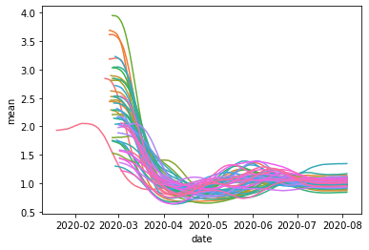
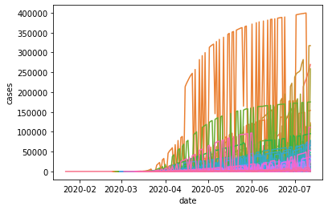
Data Insights
The key intuition from exploratory data analysis is that Risk of Transmission follows some form of time series regression, and differs by State. With this, we get a sense that we need to include time, lagged and location variables into our model.
Risk of Transmission
Cases
Each color represents a state data.

Slide 16
Data Wrangling and Feature Engineering
Reconciled state name discrepancies
Merged 7 data sources
Created time labels
Forward filled missing data
Created lagged variables
Crawled and added season variables

Slide 17
Light Gradient Boosting Machine (GBM) Model
Why LGBM?
Uses tree based learning algorithm
High speed and can handle large datasets
Uses lower memory
Focuses on accuracy of results
Model Details
Input variables: Historical cases, risk of transmission, location, weather and mobility information
Target variable: R_{t}

Slide 18
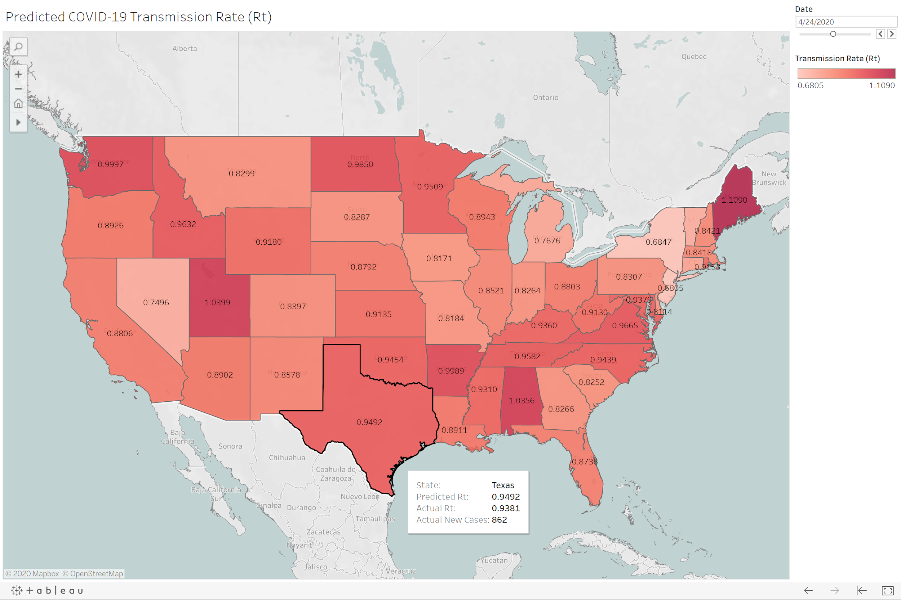
Heat Map of Predicted Transmission Rate
Both the transmission rate and the number of new cases should be taken in account to better assess the spread in the area
Interactive Map
https://public.tableau.com/profile/hieu7907#!/vizhome/PredictedCOVID-19TransmissionRate/PredictedCOVID-19TransmissionRateRt

Slide 19
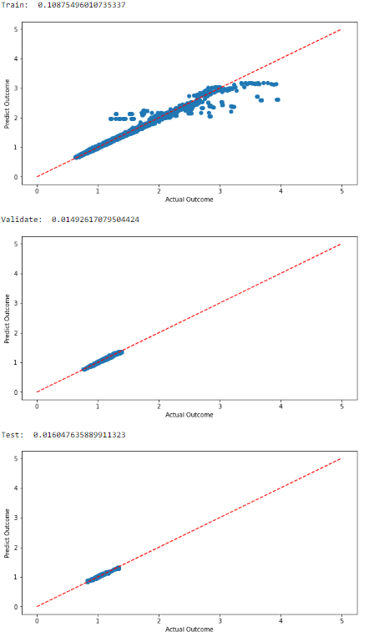
Data Visualization of Predictions
Taking only information from yesterday onwards, we are able to forecast accurately on Risk of Transmission (even for unseen Test data in the bottom Figure)

Slide 20
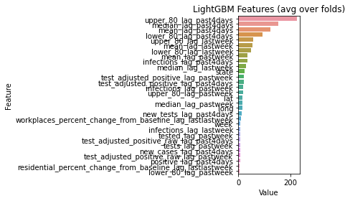
Feature Importance Intuitions
Intuitively, the most predictive features are the information representing most recent Risk of Transmission.
Interestingly, workplaces_percent_change_from_baseline_lag_lastlastweek is the most predictive mobility variable. This points towards some hypotheses that might need further investigations:
The drop in people physically having to go to work directly reduces the risk of transmission 2 weeks later.
Mobility factors that occur 2 weeks ago have an impact on Transmission Risk today (as opposed to last week) (This might be due to the lag time in getting infected, showing symptoms, and going to the doctor to be tested)

Slide 21
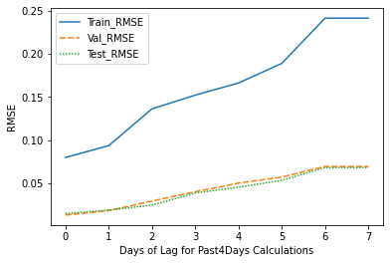
Model Extensions - Lag Information on RMSE
Naturally, our model performs best when it takes most recent information (yesterday), and works pretty well up to forecasting 4-5 days ahead.
As we move back and rely on information further into the past, RMSE for Train/Val/Test all increases. The following slide displays the scatter plot comparisons.

Slide 22
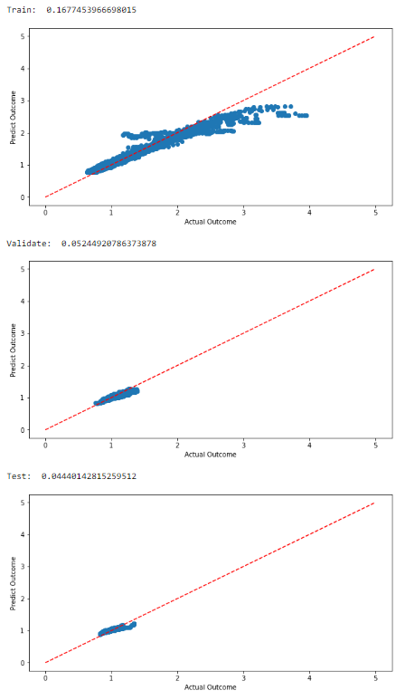
Model Extensions - Lag Information on RMSE
Lag_0 represents using all of yesterday and older information in our model.
Lag_4 represents taking only information from 5 days ago and older.
✔
Lag_0 (Per prior slide)
Lag_4

Slide 23
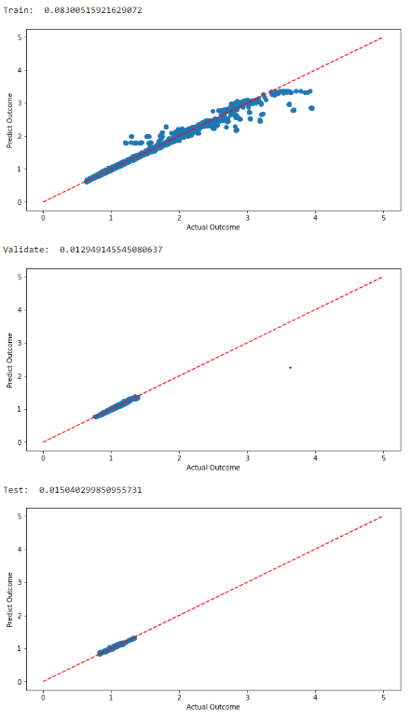
Model Extensions - Weather Information on RMSE
The intuition behind this addition was that weather could be an indicator for mobility, since people tend to spend more time outside in good weather. Adding past Wind/Temperature information does improve the model slightly!
✔
Lag_0 (Per prior slide)
Lag_0 + Lagged Weather Features

Slide 24
Next Steps
If data is available,
Perform hyperparameter tuning, cross-evaluation, try alternative models, etc.
Predict risk at city level
Predict risk at more specific locations (parks, restaurants, grocery stores, etc.)
Predict risk at specific time intervals (e.g. hourly)
Expand to global countries
Find weather API that can accomodate more than 300 requests/month
The mission of the Map My Risk app is to provide forecasted risk to help the user choose the least risk time and place.

Slide 25

With the Map My Risk App
she knows where and when she should go
Notes:
https://search.creativecommons.org/photos/dfe12207-b0d2-4bed-8037-ff721e77c342
"Young beautiful hipster woman standing crossed arms amidst nature and mountain ,Relaxing concept" by Orange Weekends is licensed under CC BY-NC 2.0

Slide 26
Additional Information
Problem Statement:
https://drive.google.com/file/d/1NItAiXI_1PMn-ltVAlnxDIZ5Osq8dmRo/view?usp=sharing
Tableau Heat Map: https://public.tableau.com/profile/hieu7907#!/vizhome/PredictedCOVID-19TransmissionRate/PredictedCOVID-19TransmissionRateRt
GitHub Repository: https://github.com/sofiasikandar1/teamlovelace

Slide 27





Team 1 - Ada Lovelace
Photos and Biographies

Slide 28
Sofia Sikandar
Sofia is hybrid of a Data Scientist and Software Developer at Booz Allen Hamilton, residing in the Washington DC Metro Area. In her undergraduate program, she studied Computational and Data Sciences and graduated in December 2019 and is now pursuing a Masters in Applied Information Technology.

Slide 29
Arias Hathaway
Arias worked as an educator after graduating with a Masters degree in mathematics in 2016. In 2020 she transitioned from education to work as a biotech market research consultant with an emphasis on healthcare data. Arias looks forward to continuing her exploration of data research with more projects and hackathons.

Slide 30
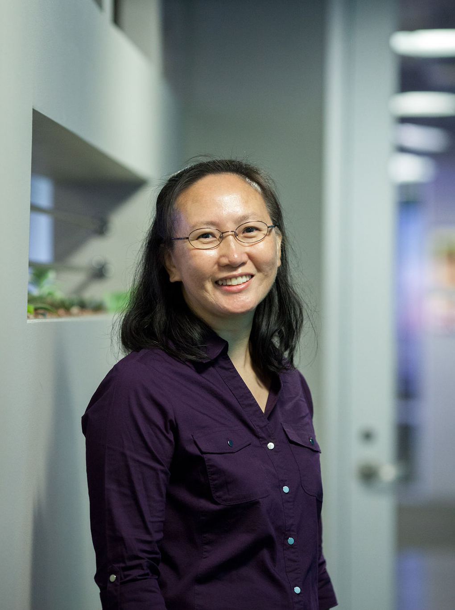
Hieu Dinh
Hieu has 9 years of experience as a Business Intelligence developer, data analyst, and data warehouse architect. She was formerly a software engineer with both a Bachelors and Masters in Management of Information Technology. She is new to data science and excited to see how this field will shape her career path.

Slide 31

Fiona Tan
Fiona is passionate about bringing insights from data and empowering women through coding. She used to work as a Data Science Analyst in the retail industry in a multinational firm, spearheading data science projects related to automation and analytics. She obtained her BSc in Econometrics and Mathematical Economics with first class honours from the London School of Economics (LSE) and is currently pursuing a PhD in Data Science at the National University of Singapore (NUS), with a focus on Natural Language Processing. In her free time, she volunteers with the organisations SheLovesData and TechLadies in her community.

Slide 32

Gabriela Trindade
Gabriela worked as Requirements Analyst and researched on Requirements Engineering during her undergraduate program and Master's degree in Computer Science. Recently, she has started her transition and is looking to start her career in Data Science. She likes to code in Python and solve mathematical problems. Occasionally, Gabriela writes on dev.to and contributes to open-source projects. At the moment, she is focusing on the study of Machine Learning.

